Slide 1
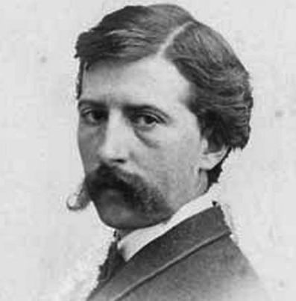
Winslow Homer

Slide 2
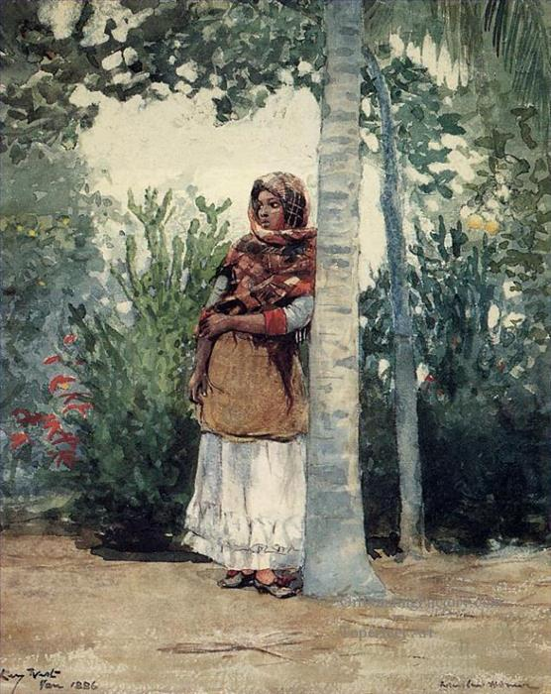
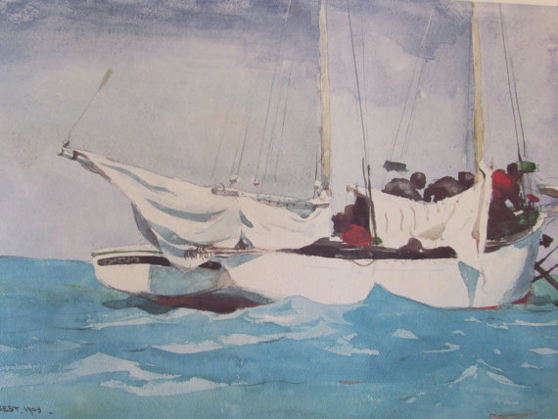
Winslow Homer, Key West,
Hauling Anchor
Winslow Homer, Under a
Palm Tree,

Slide 3
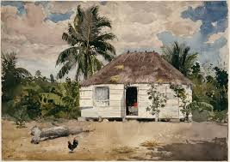
Activity search-Native Huts, Nassau
Find the following in the picture and your word search
Rooster
Palm Tree
Clouds
Sand
Sky
House
Shadow
Family

